Slide 1
CSE 4208
Introduction to OpenGL
Conducted By:
Sk. Md. Masudul Ahsan
and
Kazi Saeed Alam

Slide 2
Objective of graphics programming
To create synthetic image such a way that it is close to reality.
To create artificial animation that emulates virtual reality.
But why? We have already tools like camera to create image of natural scene and video camera for creating natural movies!

Slide 3
OpenGL – Open Graphics Library
What it is ?
  a software interface to graphics hardware
  a graphics programming library
  Dominant industry "standard" for 3D graphics
  Consists of about 150 basic commands
  Platform independent
What it is not ?
  a windowing system (no window creation)
  a UI system (no keyboard and mouse routines)
  a 3D modeling system (Open Inventor, VRML, Java3D)

Slide 4
OpenGL Related Libraries
GL – gl.h – Opengl32.lib
  Provides basic commands for graphics drawing
GLU (OpenGL Utility Library) – glu.h – glu32.lib
  Uses GL commands for performing compound graphics like
    viewing orientation and projection specification
    polygon tessellations, surface rendering etc.
GLUT (OpenGL Utility Toolkit) – glut.h – glut.lib
  is a window system-independent toolkit for user interaction

Slide 5
OpenGL Library Organization
Host OS
GLUT
User
Interface
GLU
OpenGL
Application
Program
Generic
Graphics API
Frame
Buffer
GL
DirectDraw
WGL
Either will
Exist in any
system
GLX
Xlib / Xt

Slide 6
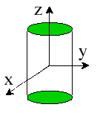
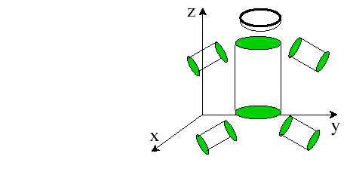
Object space and world space
Instantiate &
Modeling
Transform
World Space
Object space

Slide 7
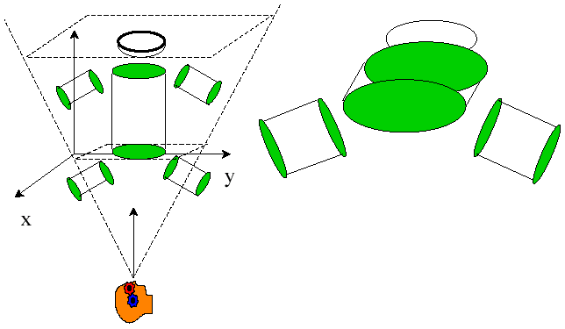
Eye space
A model can be viewed from different angles.
Viewing Transform specify following information about the viewer:
  eye position
  head up
  Look at direction
  View volume

Slide 8


Pipelined architecture
a
b
*
+
c
Arithmetic pipeline for

Slide 9
Geometric pipeline
vertices
Transformer
Clipper
Projector
Rasterizer
Pixels

Slide 10
OpenGL graphics Pipeline
Graphics
Primitives
Modeling
Transform
Viewing
Transform
Normalize
& Clip
transform
matrix
Eye, lookat,
headup
Parallel or
Perspective
volume
material,
lights, color
Shading &
Texture
Object
Space
World
Space
Eye
Space
Clipping
Space
Image
Space
Screen
Space
Device
Space
projection
matrix
Projection
viewport
location
Scan
conversion
Image on
Screen
Viewport
Transform
Image in
Internal Buffer
Rasteri-
zation

Slide 11
Convention of function naming
glColor3f(...)
Gl library
Root Command
Number of Arguments
Type of Arguments

Slide 12
OpenGL APIs
Primitive functions
  glBegin(type);
    glVertex(…);
    glVertex(…);
    …
    glVertex(…);
  glEnd();
Attribute functions
  glColor3f(…);

Slide 13
OpenGL APIs
Transformation functions
  glRotate(…); glTranslate(…);
Viewing functions
  gluLookAt(…);
Input functions
  glutKeyboardFunc(…);
Control functions
Inquiry functions

Slide 14
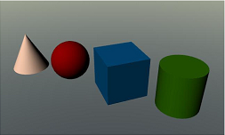
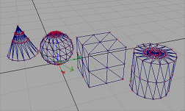
Primitives
Primitives: Points, Lines & Polygons
Each object is specified by a set of
Vertices
Grouped together by glBegin & glEnd
glBegin(type)
glVertex*( )
glVertex*( )
…
glEnd( );
type can have 10
possible values
To specify attributes of last Vertex drawn:
  glColor*()/ glIndex*() current vertex color
  glNormal*() current vertex normal (lighting)
  glMaterial*() current material property (lighting)
  glTexCoord*() current texture coordinate
  glEdgeFlag*() edge status (surface primitives)

Slide 15

Primitive Types
V₄
V₄
V₀
V₀
V₀
V₄
V₃
V₃
V₅
V₅
V₅
V₃
V₂
V₁
V₂
V₁
V₁
V₂
GL_LINES
GL_LINE_STRIP
GL_LINE_LOOP
Polygon must be:
Simple
No-holes inside
Convex
V₄
V₄
V₀
V₃
V₃
Simple
Non-convex
V₅
V₀
V₂
V₂
V₁
V₁
P₁
GL_POINTS
GL_POLYGON
P₂
Convex
Complex

Slide 16
Primitive Types
V₈
V₇
V₀
V₂
V₂
V₁
V₄
V₃
V₆
V₄
V₁
V₁
V₂
V₅
V₄
V₀
V₀
V₃
V₃
V₅
V₅
GL_TRIANGLES
GL_TRIANGLE_STRIP
GL_TRIANGLE_FAN
Order of Vertex rendering
V₀
V₀
V₂
V₄
GL_TRIANGLE_STRIP
  012, 213, 234, 435
V₃
V₆
V₇
V₁
V₆
GL_QUAD_STRIP
  0132, 2354, 4576
V₂
V₄
V₁
V₃
V₅
V₇
V₅
GL_TRIANGLE_FAN
  012, 023 , 034, 045
GL_QUADS
GL_QUAD_STRIP

Slide 17
Finally
Making your programming environment ready
Let’s see some projects
Your first program
Now try with some more stuffs

